Slide 1
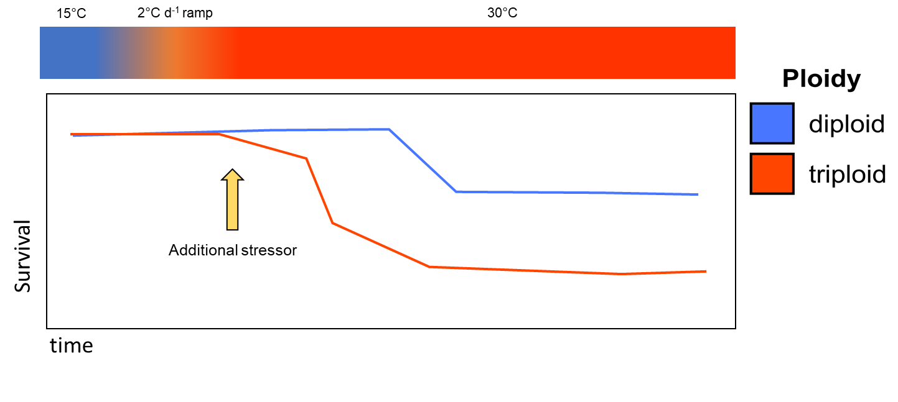
EXP2 - Study Design
Sampling regime
Tissue
SMR
FR
baseline
After temp-ramp
After desiccation
10 days after stress
20 days after stress

